Slide 1
SOFTWARE ENGINEERING
Socio-technical systems

Slide 2
System/Complex System ?
“A system is a purposeful collection of interrelated components that work together to achieve some objective”
System that includes s/w fall into two categories
– Technical computer-based systems
Systems that includes hardware and software components but not procedures and processes.
– Socio-technical systems
●
Systems that include technical systems but also operational processes and people who use and interact with the technical system. Socio- technical systems are governed by organisational policies and rules.
●

Slide 3



Technical Computer-based Systems
System that include hardware and software but where the operators and operational processes not normally considered to be part of the system.

Slide 4
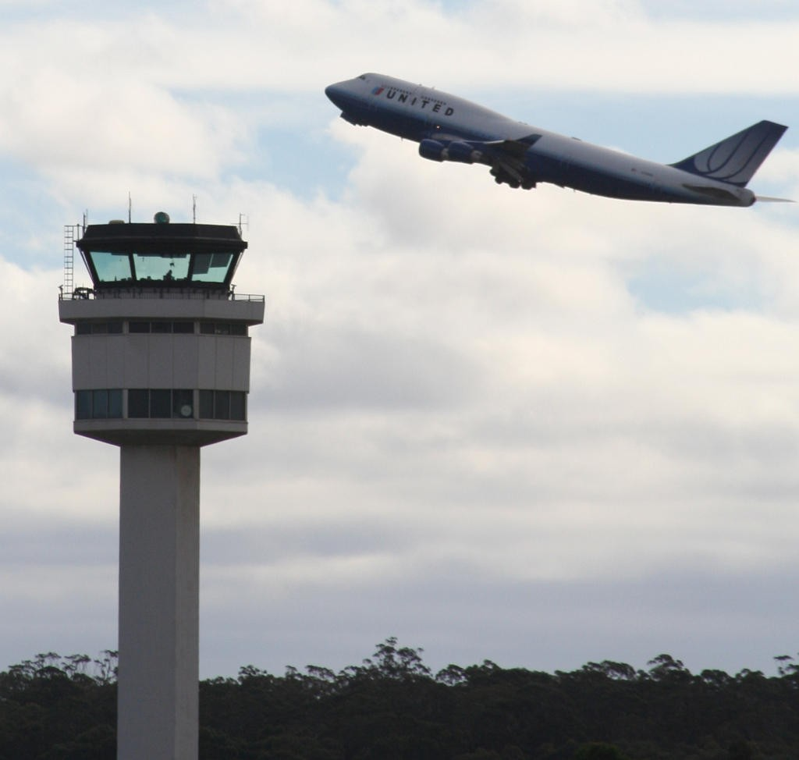


Socio-technical System
System that include technical systems but also operational processes and people who use and interact with the technical system.
Socio-technical systems are governed by organizational policies and rules.

Slide 5
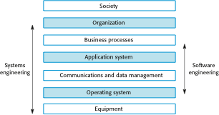
Sociotechnical System Stack

Slide 6
Layers in the STS stacks
Equipment
Hardware devices , some of which may be computers.Most devices will include an embedded system of some kind.
Operating System
Provides a set of common facilities for higher levels in the system.
Communications and data management
Middleware that provides access to remote systems and databases.
Application systems
Specific functionality to meet some organization requirements
●
●
●
●

Slide 7
Layers in the STS stacks
Business processes
A set of processes involving people and computer systems that support the activities of the business
Organizations
Higher level strategic business activities that affect the operation of the system.
Society
Laws , regulation and culture that affect the operation of the system.
●
●
●

Slide 8
Holistic System Design
There are interactions and dependencies between the layers in a system and changes atone level ripple through the other levels.
– Change is regulation leads to changes in business processes and application software

Slide 9
Stages of Systems Engineering
There are three overlapping stages in the lifetime of large and complex sociotechnical systems :-
Procurement or Acquisition
Development
Operation
●

Slide 10
Procurement or Acquisition
It includes :-
Purpose of system is decided
High-level system requirements are established
Decision are made on how functionality will be distributed across hardware , software and people
and ,components that will make up the system are purchased
●

Slide 11
Development
It includes :-
– development activities related to
●
●
System Developments (requirements definition , system design , hardware and software engineering , system integration and testing)
operational Processes are defined
the training courses for system users are designed.
●
●

Slide 12
Operation
It includes :-
System is deployed
Users are trainined
System is brought into use
●

